Slide 1


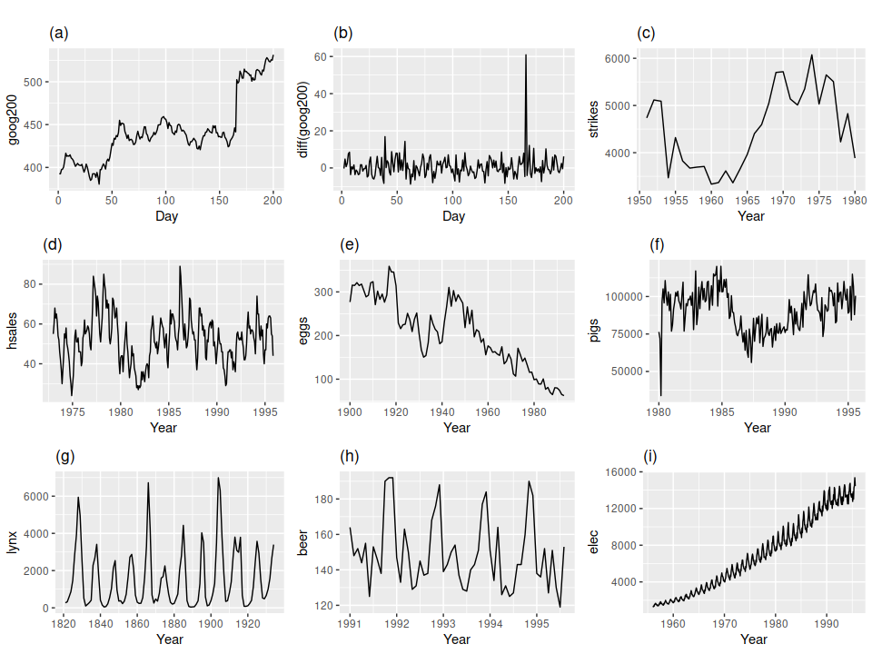
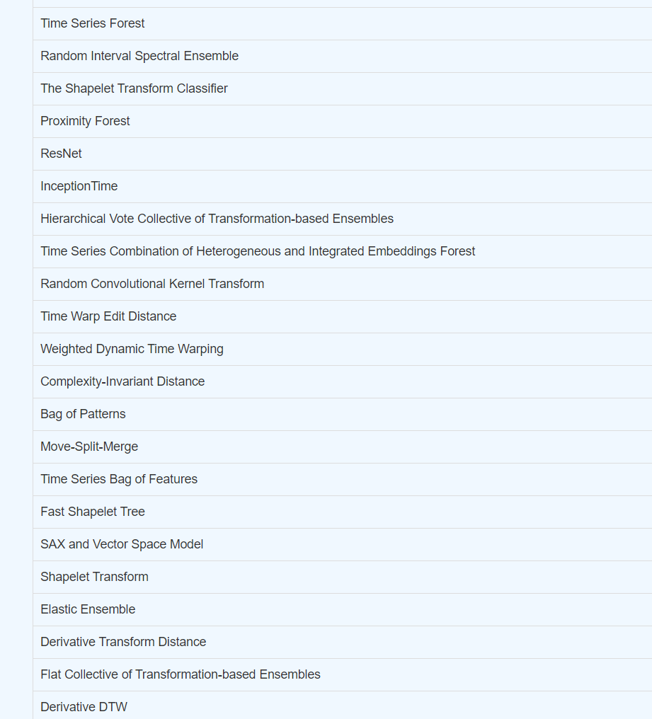
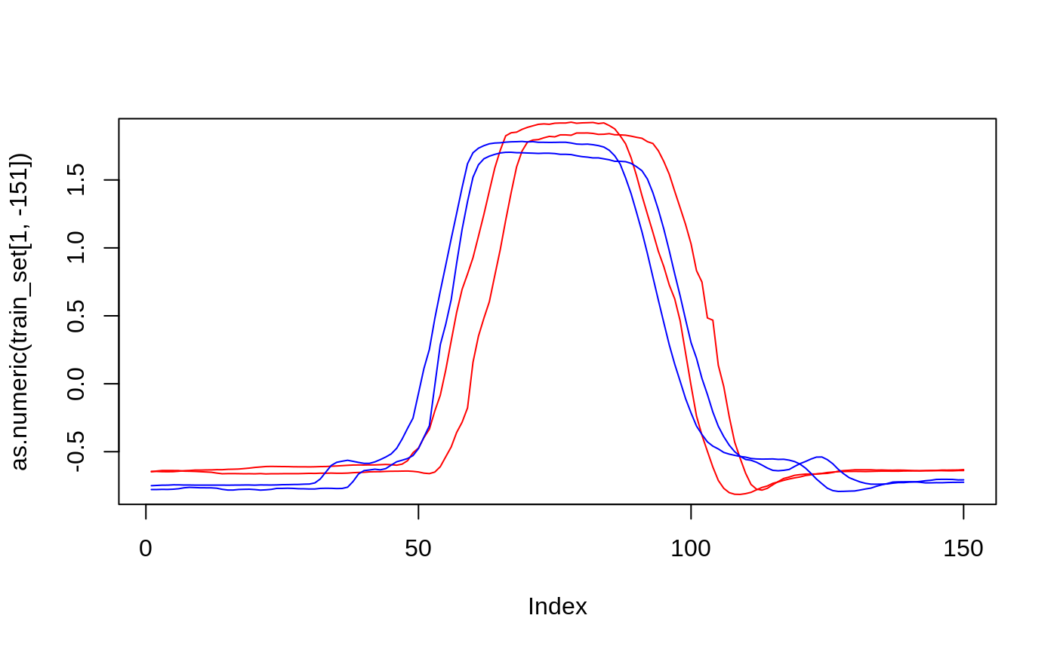

Define as a learning problem?
How to describe time series in meta space?
Recommend a method?
What to use?
Framework for meta learning for time series classification/regression/anomaly detection …
Meta-learning for time series classification
Jasmin Bogatinovski

Slide 2
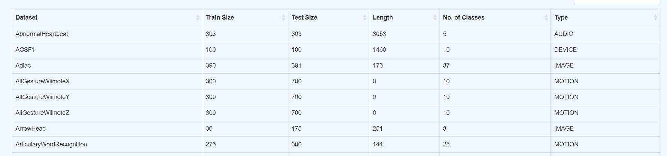
Problem motivation
Time series classification is a relative problem for many scientific disciplines:
which type of class is related with what kind of anomaly (predictive maintenance, IT systems)
Medicine (EEG, ECG classification)
Physics (type of motion etc.)
etc,.
More DATASETS can be found here:
http://www.timeseriesclassification.com/dataset.php
How to utilize existing studies to foster the selection and improve the trust in machine learning methods for time series classification for novel problems?
More METHODS can be found here:
http://www.timeseriesclassification.com/algorithm.php
Notes:
As you have seen I have some experience in working with time series data. Also I have numerical data I can classifiy. To that end I have run into this problem.
Let’s imagine we have a new dataset for time series classification with
<number>

Slide 3
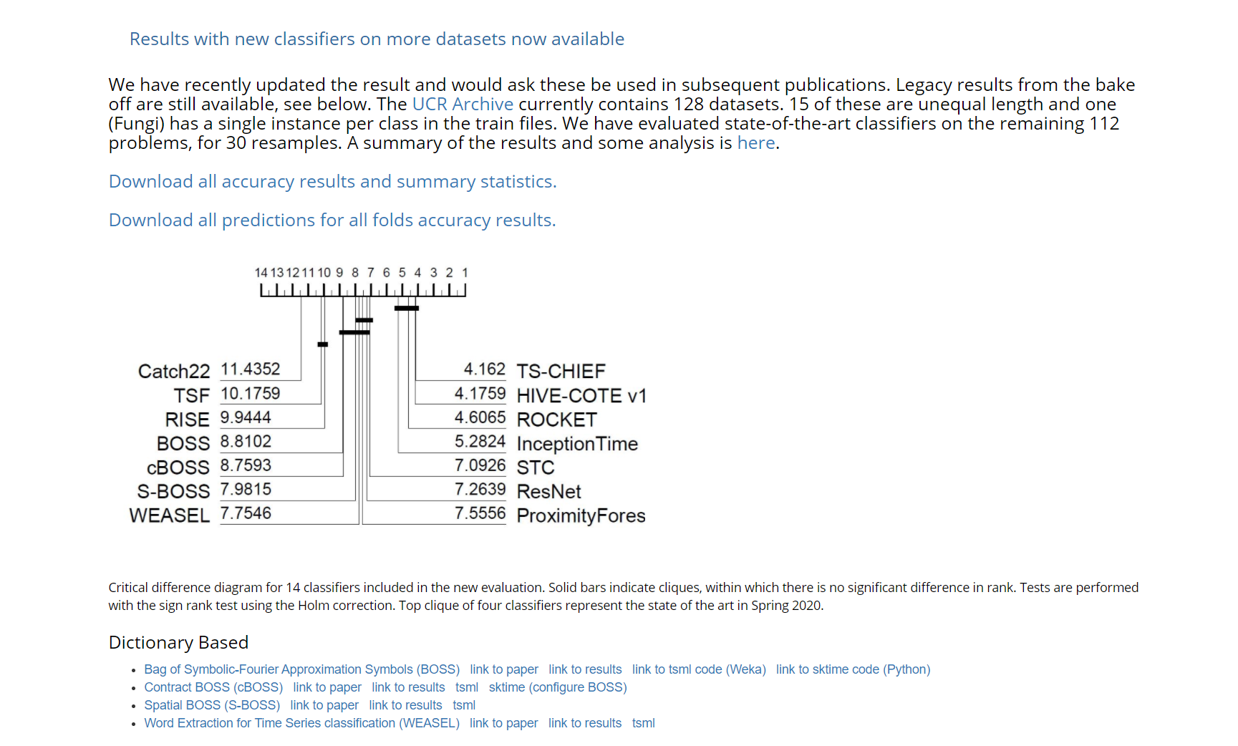
Problem motivation
Classifiers: 14 classifiers
Results: 30-fold splits (all res available)
Performance measures:
10 performance: ACC, BACC, Precision, Recall, NLL, Sens, Spec, AUROC, MCC, F1
2 efficiency: MaxMemory, Time,
Number of datasets: 109
Families of methods: 6
Datasets available !!!
One challenge is the different framework of implementation of the methods if one wants to run them !!!
More RESULTS can be found here:
http://www.timeseriesclassification.com/results.php
Notes:
As you have seen I have some experience in working with time series data. Also I have numerical data I can classifiy. To that end I have run into this problem.
Let’s imagine we have a new dataset for time series classification with
<number>

Slide 4
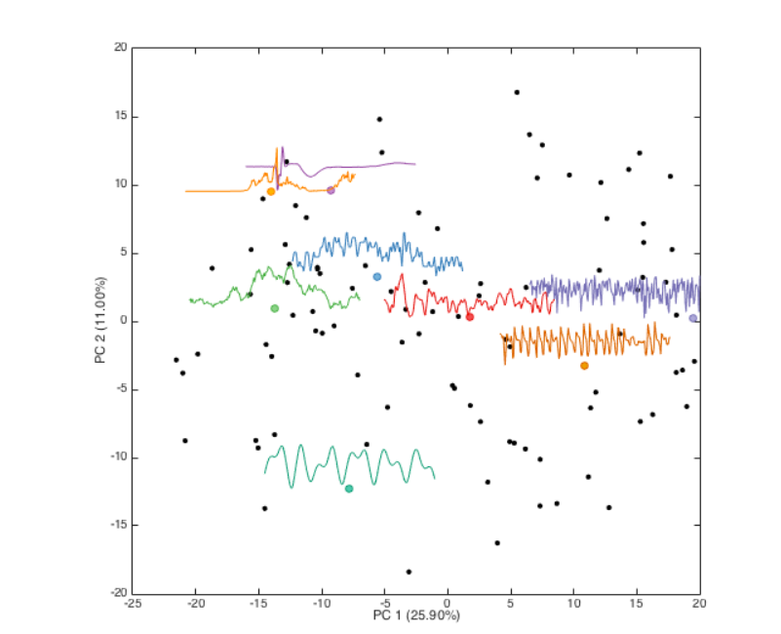
Available set of datasets for time series classification
Problem description
Available set of methods for time-series classification
Define as a learning problem?
How to describe time series in meta space?
Recommend a method?
What to use?
Framework for meta learning for time series classification/regression/anomaly detection …
Novel time series classification problem
http://www.timeseriesclassification.com/
Notes:
As you have seen I have some experience in working with time series data. Also I have numerical data I can classifiy. To that end I have run into this problem.
Let’s imagine we have a new dataset for time series classification with
<number>

Slide 5
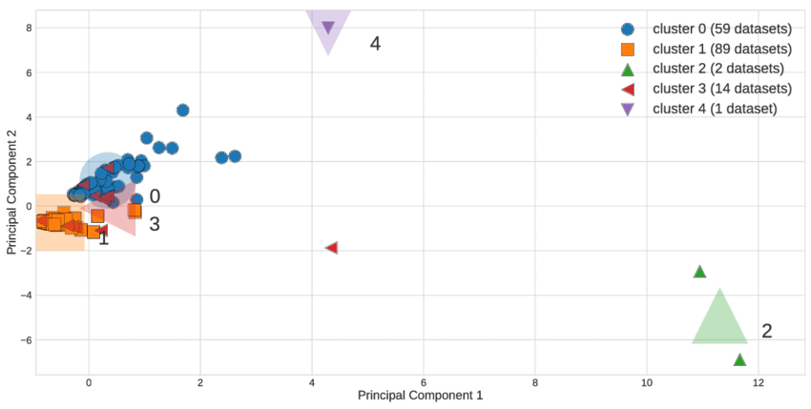
How to describe time series in meta space?
1)
Take RAW datasets
Train + test in one .csv file
1)
Take RAW datasets
Train + test in one .csv file
2)
Run tsfresh or hctsa
Transform to tabular data
Subproblem: filter out data e.g use “fresh” algorithm [1]
2)
Calculate direct meta features representation:
Example of features:
Number of motifs per class, mean/median/var of number of motifs per class
Number of shapelets per class, mean/median/var/kurtosis and any other higher order statistic of the shapelets per class
Frequency of motifs and shaplets et
Average 1NN DTW distance between classes
Etc etc… (See for other inspiration in [2] and any other package)
3)
Run MFE (Rivoli)
[1] Christ, M., Kempa-Liehr, A.W. and Feindt, M. (2016). Distributed and parallel time series feature extraction for industrial big data applications. ArXiv e-prints: 1610.07717 URL: http://adsabs.harvard.edu/abs/2016arXiv161007717C
[2] https://arxiv.org/pdf/1808.10406.pdf
TWO IDEAS
EXPENSIVE!!!
Notes:
Define as a learning problem?
<number>

Slide 6
Recommend a method? How to treat the problem:
Single objective best performing method on one measure (accuracy, F1, memory, efficiency etc… ) binary/multi-class classification or r
How to organize the methods? By family of methods and treat the problem as multi-class classification ?
Define it as a multi-objective optimization problem and observe (F1, time and memory at the same time). One can perform discretization and treat the problem as multi-label or directly as multi-target regression\
THESE 3 things are relevant for you.
Notes:
Define as a learning problem?
<number>

Slide 7
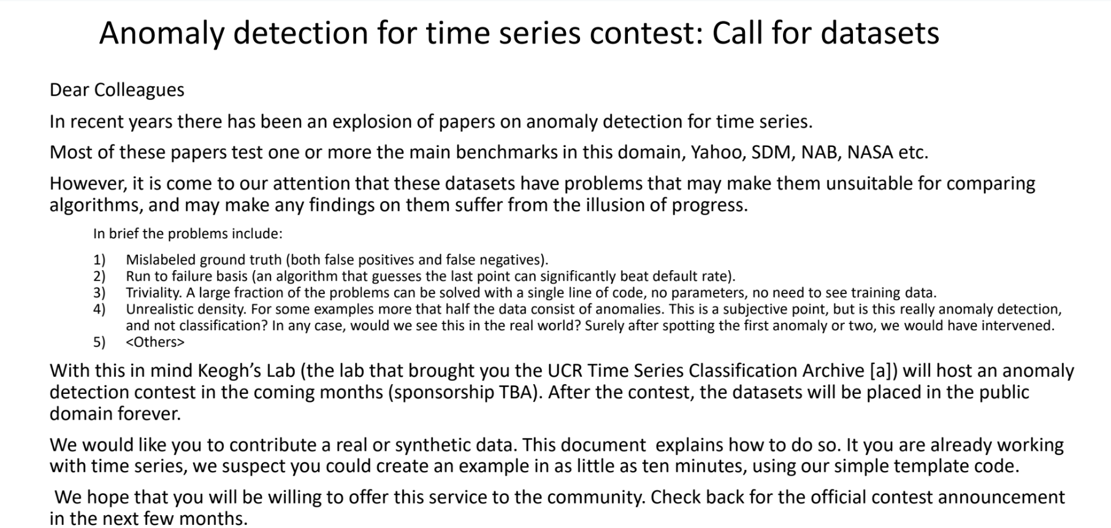
Future work
https://www.dropbox.com/sh/gsvm653d0m8tk41/AACjAhEiPl5GleCQeyd-NM0Na?dl=0

Slide 8
References
CORE PAPER: https://link.springer.com/article/10.1007/s10618-016-0483-9
Time series classification an overview: https://hal.archives-ouvertes.fr/hal-02365025v2/document
HCTSA: https://link.springer.com/article/10.1007/s10618-019-00647-x
Time series data type, task analysis review: https://www.sciencedirect.com/science/article/abs/pii/S0952197610001727
Notes:
<number>

